Slide 1
Lending Club Case Study
Submitted by – Sidharth Rai (5760097)
Sourav Sirohi (5623940)
An assignment for upGrad and IIITB Machine Learning & AI Program.

Slide 2

CONTENTS
Problem Statement
Analysis Approach
Univariate Analysis
Impactful Column Selection
Bivariate Analysis
Conclusion
Recommendation

Slide 3
Problem statement
Business Understanding:
Lending Club, a consumer finance company which specializes in lending various types of loans to urban customers.
There are two primary risks associated with loan approval decisions: l
Loss of business if loans aren't approved.
Financial loss if loans default.
The dataset provided contains information on past loan applicants and their loan statuses, aiming to identify patterns indicating loan default tendencies.
Business Objective:
Minimize credit loss by identifying risky loan applicants.
Understand the driving factors behind loan default to optimize risk assessment and reduce credit loss.
By identifying risky loan applicants, the company aims to reduce credit loss and enhance risk assessment processes.
Data Understanding:
The dataset contains complete loan data for all loans issued from 2007 to 2011, including information on loan statuses such as 'Fully Paid' and 'Charged Off’.
Referring to the provided data dictionary for a description of the variables included in the dataset.

Slide 4

Analysis Approach
Data Cleaning
Data Understanding
Identifying the business use case of each column from the provided Data Dictionary*.
Bivariate Data Analysis
Univariate Data Analysis
Conclusions
Observing each column one after the another, with describe, value count functions or visualization, dropping and selecting columns based upon business problem requirement.
Dropping the null valued columns
Relative analysis of columns with Loan Status column to determine the direct or indirect impact.
Recommendations
Key factors include loan maturity, borrower grade, small business loans, and state-wise default rates, guiding informed lending decisions.
Emphasize quality over quantity in long-term loans, exercise prudence with small business lending, and reassess operations in high-default states.

Slide 5
Univariate Analysis
Unpacking loan dataset columns to understand their individual characteristics and relevance to loan default prediction.

Slide 6
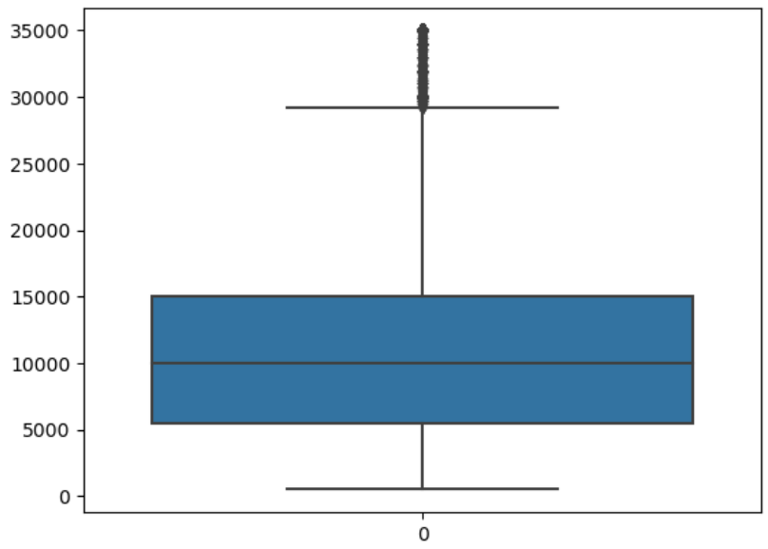
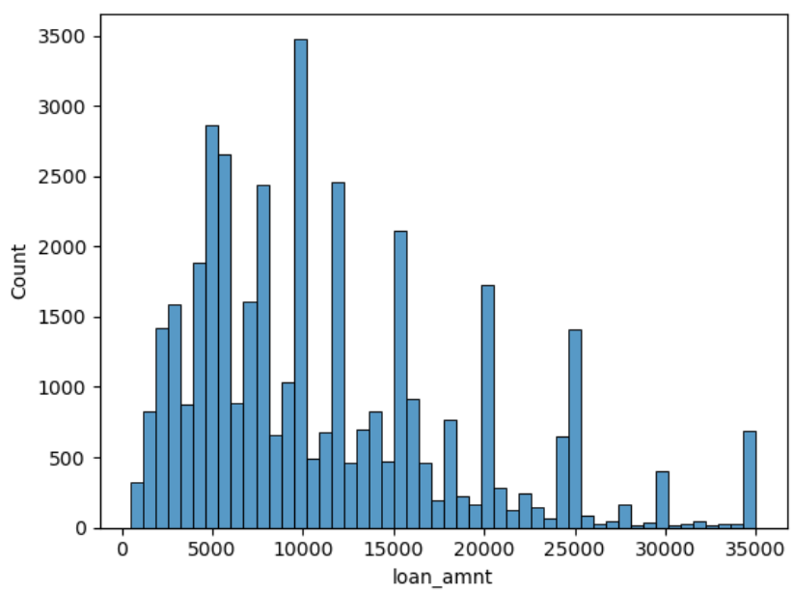
Loan Amount (loan_amnt) The listed amount of the loan applied for by the borrower. If at some point in time, the credit department reduces the loan amount, then it will be reflected in this value
Observations
Loan amount distribution is right-skewed, with higher values towards the upper range.
Box plot indicates outliers at the higher end.
Demand peaks for amounts in multiples of 5000 (e.g., 5000, 10000).

Slide 7

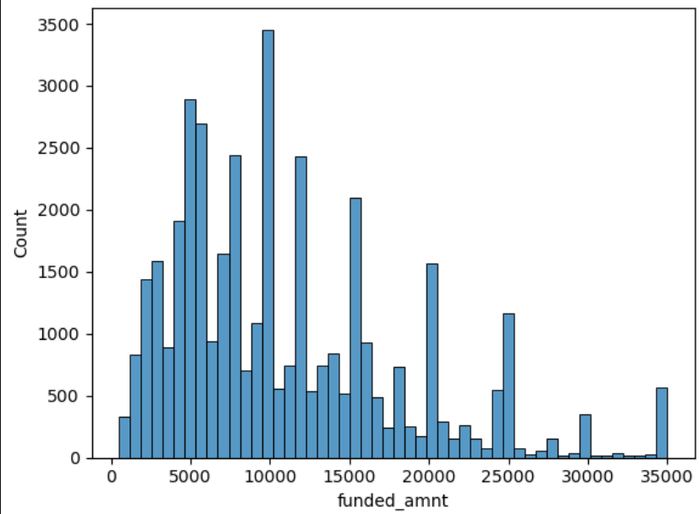
Funded Amount (funded_amnt) The total amount committed to that loan at that point in time.
Observations
Right-skewed distribution with outliers at higher values.
Box plot confirms skewness and presence of outliers.
Peaks observed for amounts in multiples of 5000.
Distribution pattern mirrors loan requested amount distribution.

Slide 8

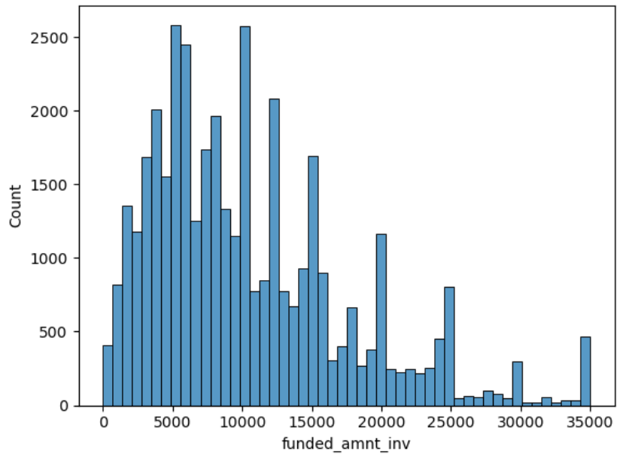
Funded Amount Inv (funded_amnt_inv) The total amount committed by investors for that loan at that point in time.
Observations
Right-skewed distribution with outliers at higher values.
Box plot confirms skewness and presence of outliers.
Peaks observed for amounts in multiples of 5000.
Distribution pattern mirrors loan requested amount and committed amount.

Slide 9
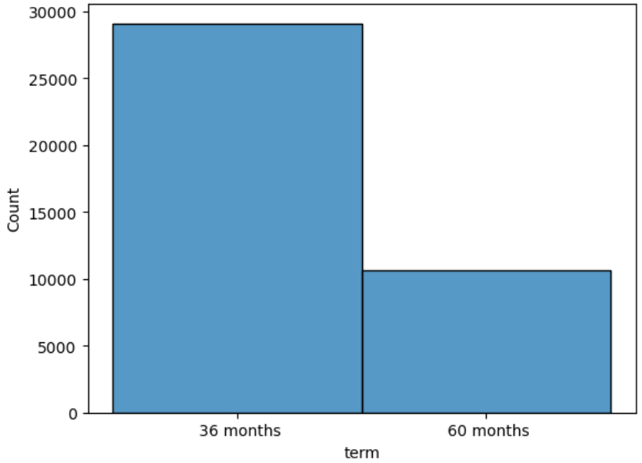
Term (term) The number of payments on the loan. Values are in months and can be either 36 or 60.
Observations
Categorical attribute with 36-month or 60-month terms.
Approximately 73% of loans have a 3-year tenure, while 27% have a 5-year tenure.

Slide 10
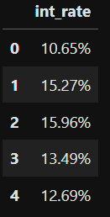
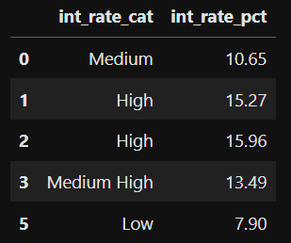
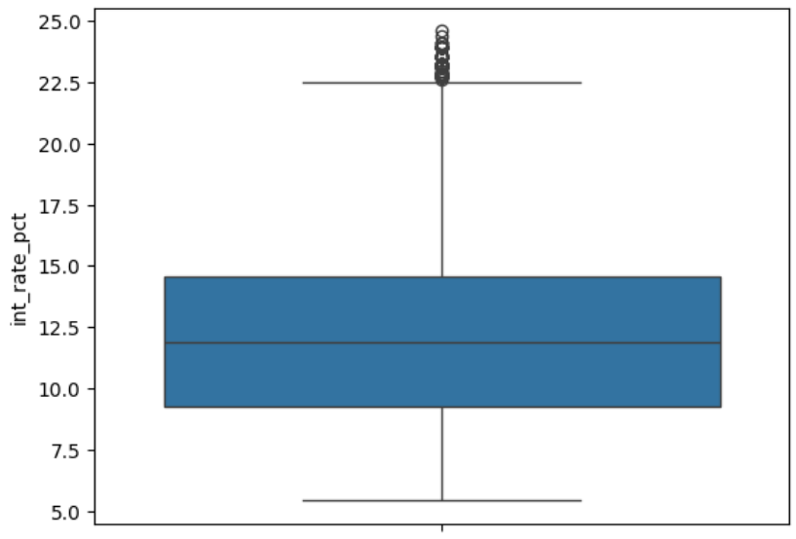
Interest Rate Percentage (int_rate) Interest Rate on the loan.
Dropped ‘%’ symbol, from object datatype to float datatype.
Created a categorical variable based on interest rate.
Upto 1st quartile will be classified as ‘Low Interest’.
From 1st quartile to median will be classified as ‘Medium’.
From median to 75th quartile will be classified as ‘Medium High’
From 75th quartile to 100th quartile will be classified as ‘High’
Outlier will be classified as ‘Extremely High’.
High Interest Rate may lead to high chances of defaulting.

Slide 11
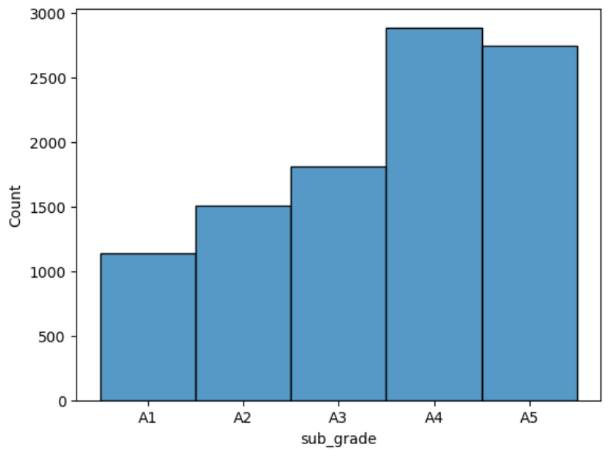
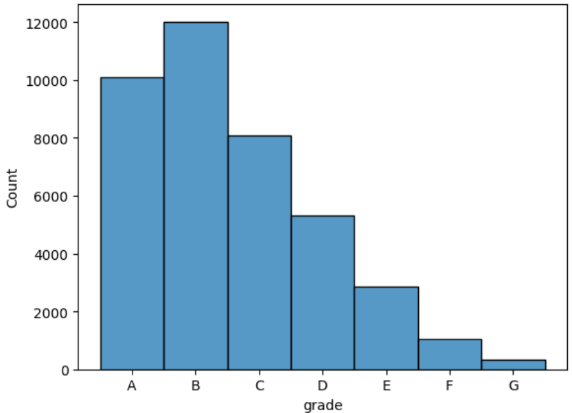
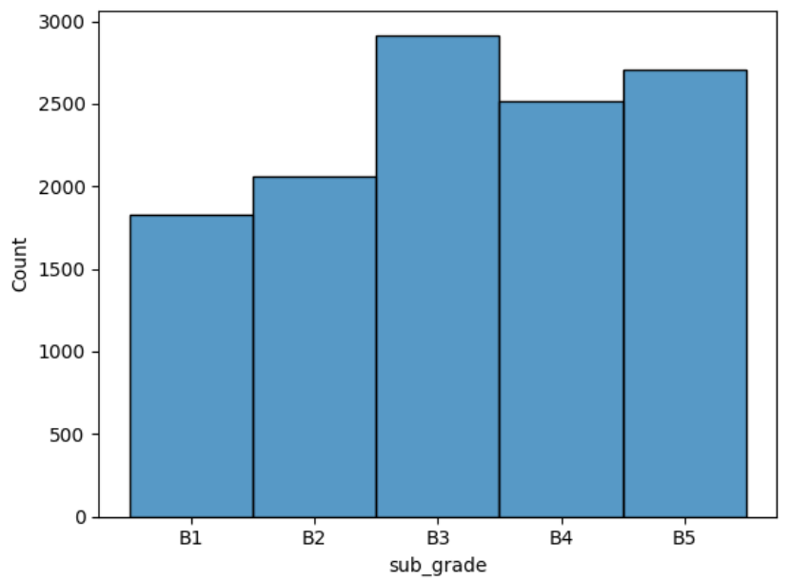
Grade and Sub Grade (grade & sub_grade) LC assigned loan grade and sub grade
Observations:
Grade signifies borrower creditworthiness from A to G.
Subgrade divides each grade into 5 categories, reflecting increasing risk.
Majority of borrowers fall under Grade B, with decreasing numbers towards higher risk grades.

Slide 12
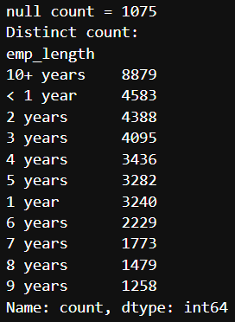
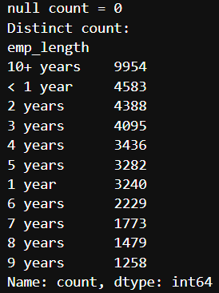
Employment Length (emp_length) Employment length in years. Possible values are between 0 and 10 where 0 means less than one year and 10 means ten or more years.
Observations:
1075 observations have null values in employee length.
These null values will be replaced with "10+ years", the most frequent category. (mode)

Slide 13
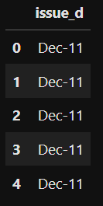
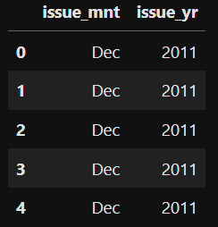
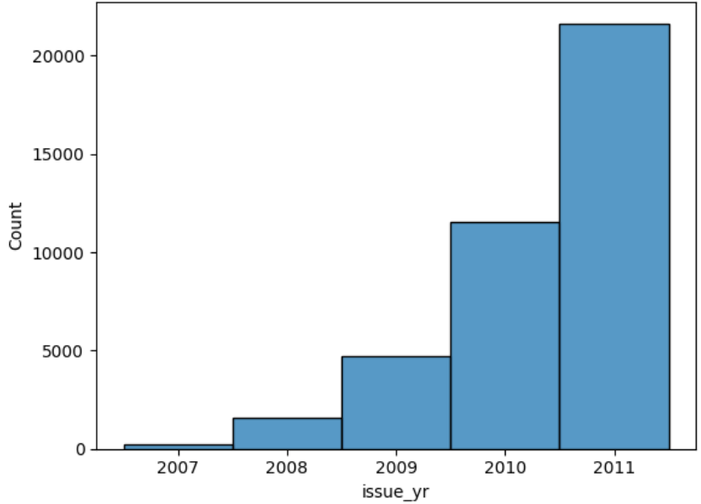
Issue Date (issue_d) The month & year which the loan was funded.
Observations:
Month and year can be extracted into separate columns.
Issue date spans from June 2007 to December 2011.
Loan issuance increased annually from 2007 to 2011.
Each year, loan issuance increased steadily from January to December, except for 2007 and 2008.

Slide 14

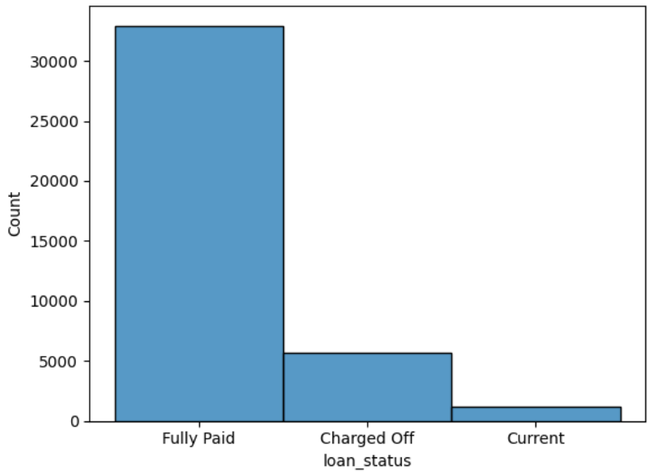

Loan Status (loan_status) Current Status of the loan
Observations:
83% borrowers fully paid, 14% defaulted, 3% in currently active.
Active borrowers' data irrelevant, will be dropped

Slide 15
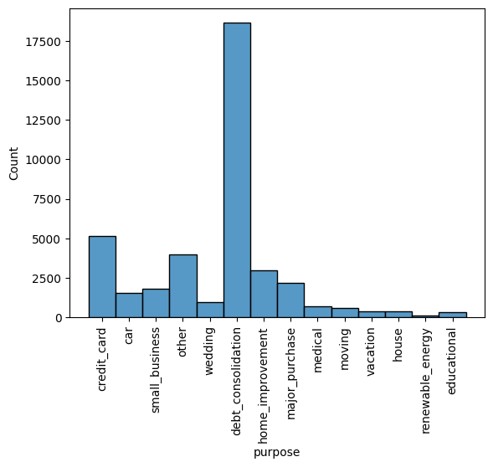
Purpose (purpose) A category provided by the borrower for the loan request.
Observations:
Over 60% loans for debt consolidation or credit card payment.

Slide 16
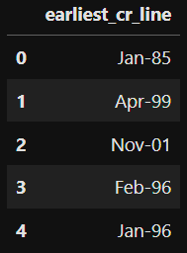
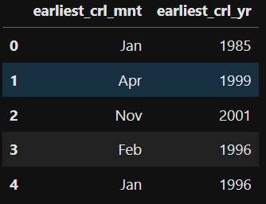
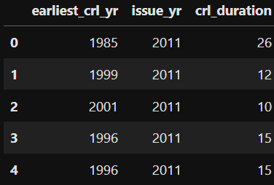
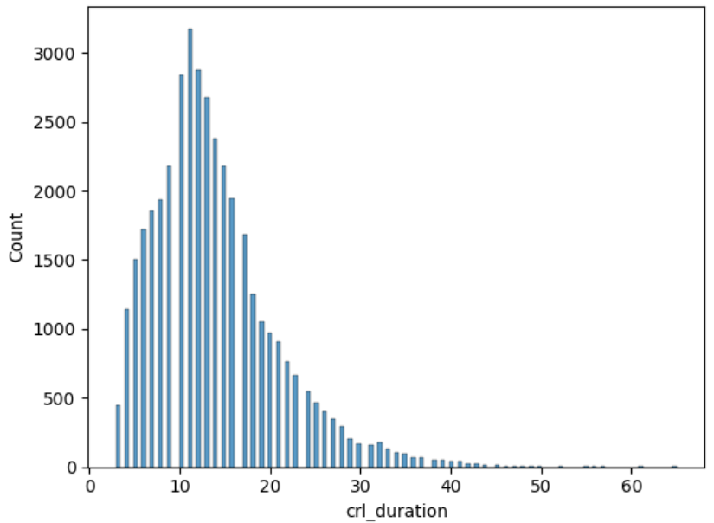
Earliest Credit Line (earliest_cr_line) The month the borrower's earliest reported credit line was opened.
Observations:
Derive length of credit history (len_cr_hist) from issue month and year.
Create crl_duration by subtracting earliest credit line year from issue year.
Credit line duration distribution is highly skewed.

Slide 17
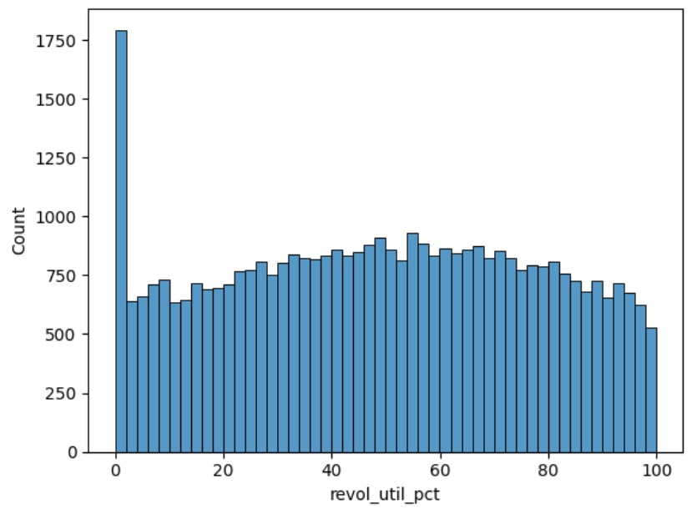
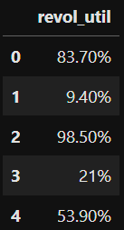
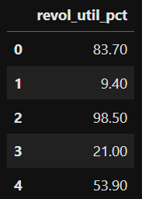
Revolving Utilization (revol_util) Revolving line utilization rate, or the amount of credit the borrower is using relative to all available revolving credit.
Observations:
revol_util converted to floating point as revol_util_pct for analysis.
Distribution uniform except for 0% utilization cases.
50 null occurrences filled with 0, the most frequent value.

Slide 18
Impactful Column Selection Out of 111 Columns
Modified or Used
Dropped or Not Used
loan_amnt
funded_amnt
funded_amnt_inv
term
int_rate_cat
int_rate_pct
installment
grade
subgrade
emp_length
home_ownership
annual_inc
verification_status
issue_mnt
issue_yr
loan_status
purpose
addr_state
dti
delinq_2yrs
earliest_crl_mnt
earliest_crl_yr
crl_duration
inq_last_6mths
open_acc
pub_rec
revol_bal
revol_util_pct
pub_rec_bankruptcies
Dropped 54 Null Valued Columns.
id
member_id
int_rate
emp_title
issue_d
pymnt_plan
url
desc
title
zip_code
earliest_cr_line
mths_since_last_delinq
nxt_pymnt_d
mths_since_last_record
initial_list_status
collections_12_mths_ex_med
policy_code
application_type
acc_now_delinq
chargeoff_within_12_mths
delinq_amnt
tax_liens
out_prncp
out_prncp_inv
total_pymnt
total_pymnt_inv
total_rec_prncp
total_rec_int
total_rec_late_fee
recoveries
collection_recovery_fee
last_pymnt_amnt
last_pymnt_d
last_credit_pull_d
revol_util

Slide 19
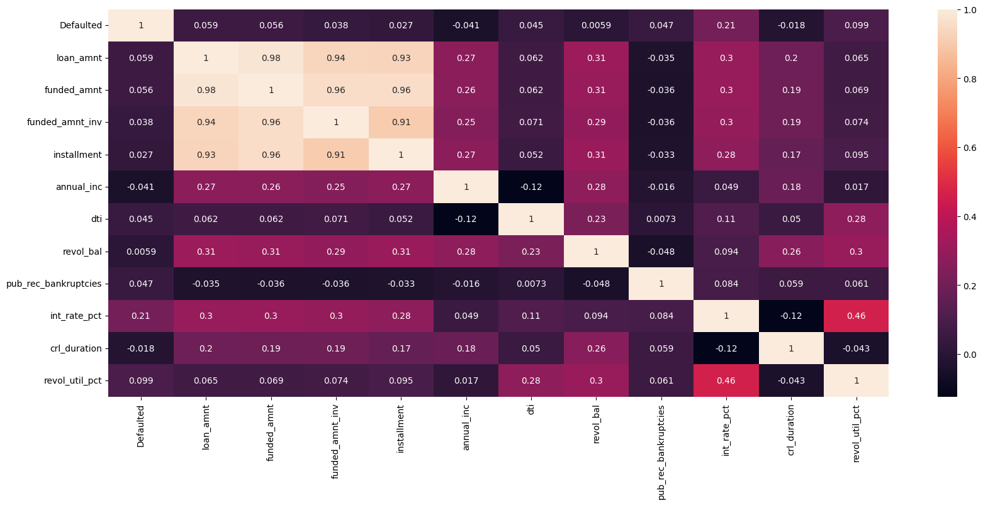
Correlation Matrix (Heatmap)
Observation
No strong correlations observed with default in the heatmap.

Slide 20
Bivariate Analysis
Explore how attributes relate to loan default through paired analysis.

Slide 21
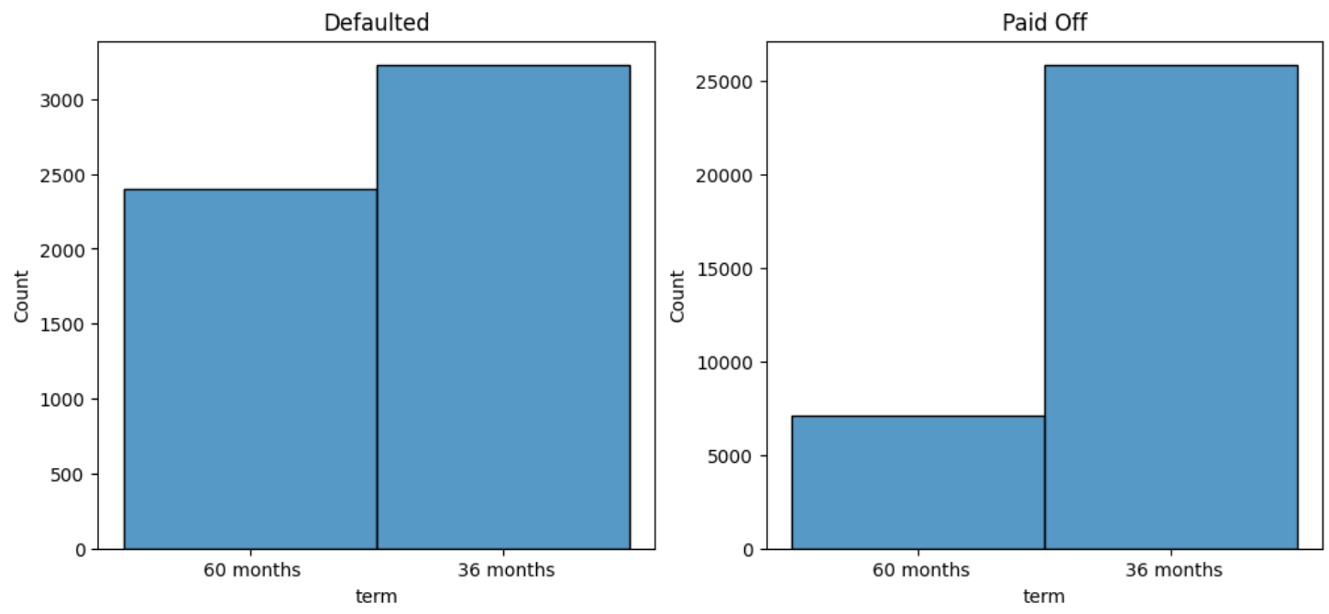
Term vs Loan Status
Observations:
Defaulters show higher incidence of long-term loans than fully paid borrowers.

Slide 22
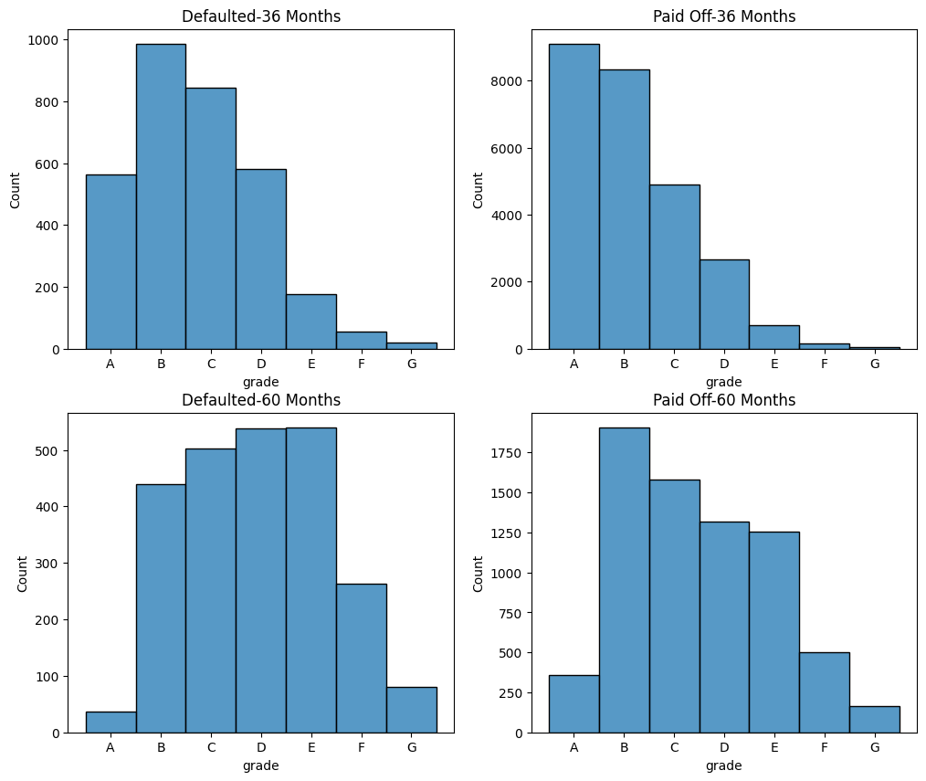
Grade vs Term on Loan Status
Observations:
Customers categorized as low graded opt for Long Term more and have eventually defaulted more as well.

Slide 23
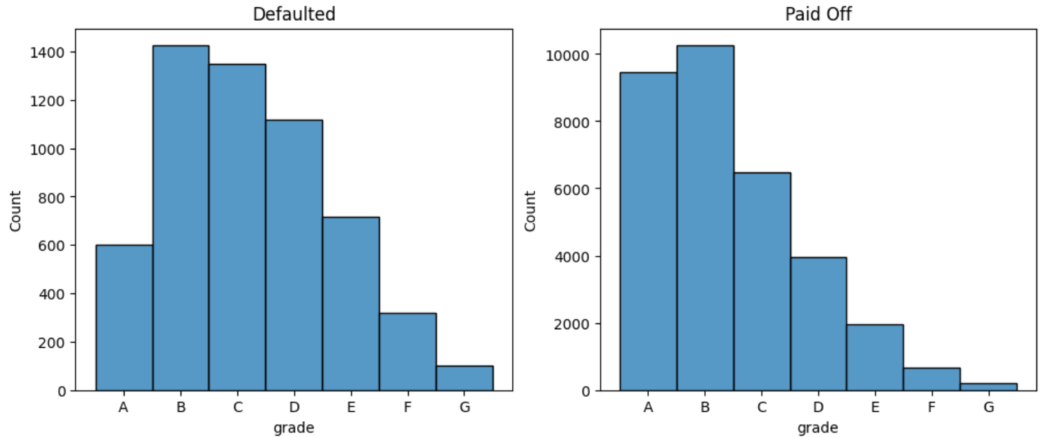
Grade vs Loan Status
Observations:
Lower the grades higher is the defaulted ratio.

Slide 24
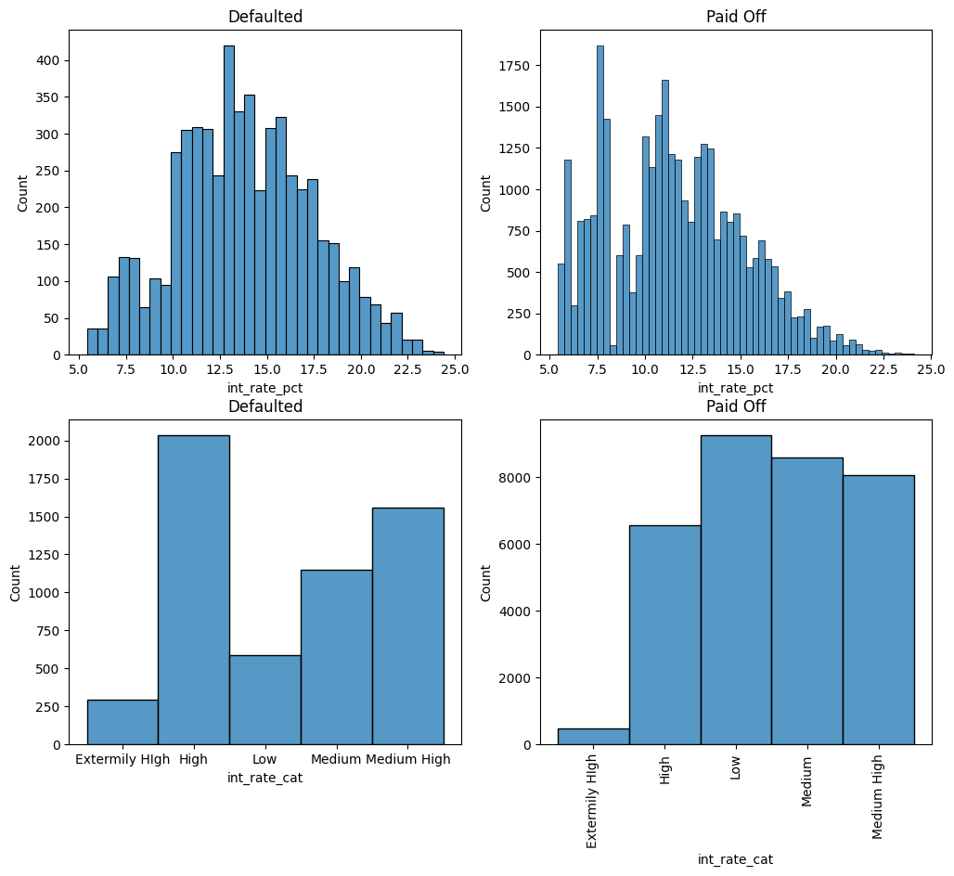
Interest Rate vs Loan Status
Observations:
Defaulted portfolio exhibits fatter tails in interest rate distribution, suggesting a potential link to higher default likelihood.
Higher interest rates may indicate higher default risk, but financial institutions often charge more to compensate for risk.
Hence, Interest rates alone are not reliable predictors of default.

Slide 25
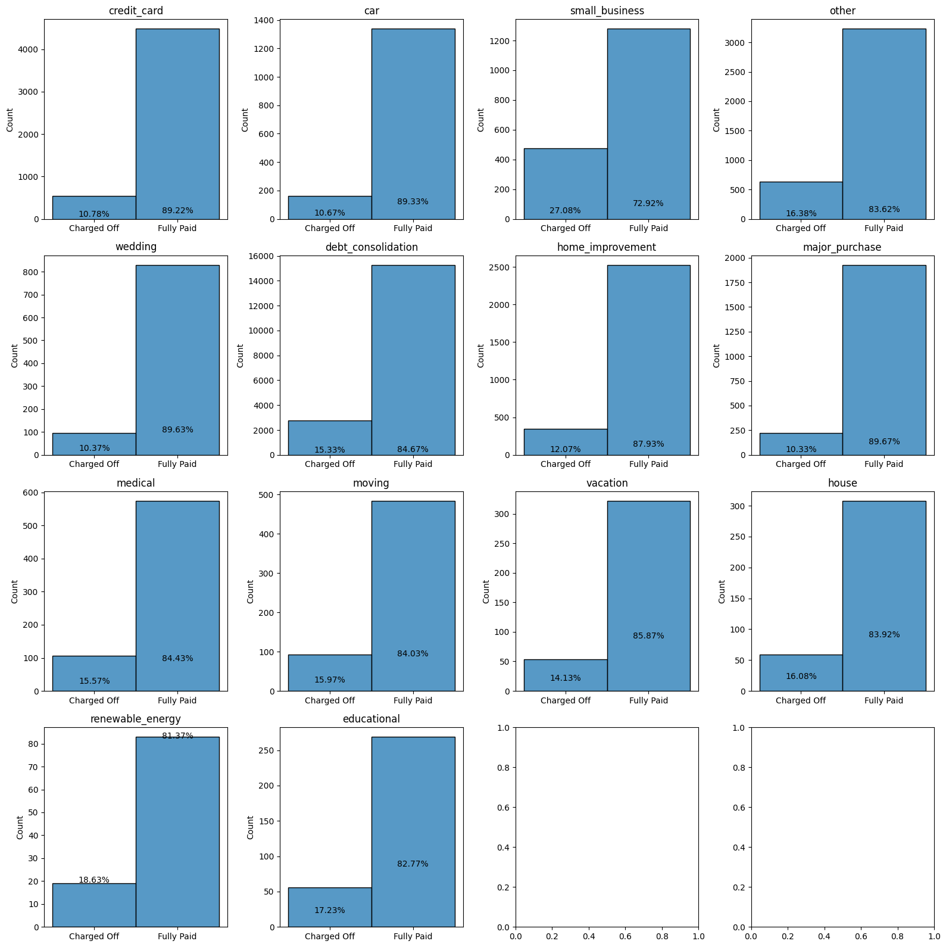
Purpose vs Loan Status
Observations:
Small business loans have the highest default rate at 27%.
Renewable energy and educational loans also exhibit relatively higher default rates, though not as high as small business loans.

Slide 26
State vs Loan Status
Observations:
MO, FL, NV, AK, SD, NE have higher default rates. NV and NE stand out with the highest default ratios: 22% and 40%, respectively.

Slide 27
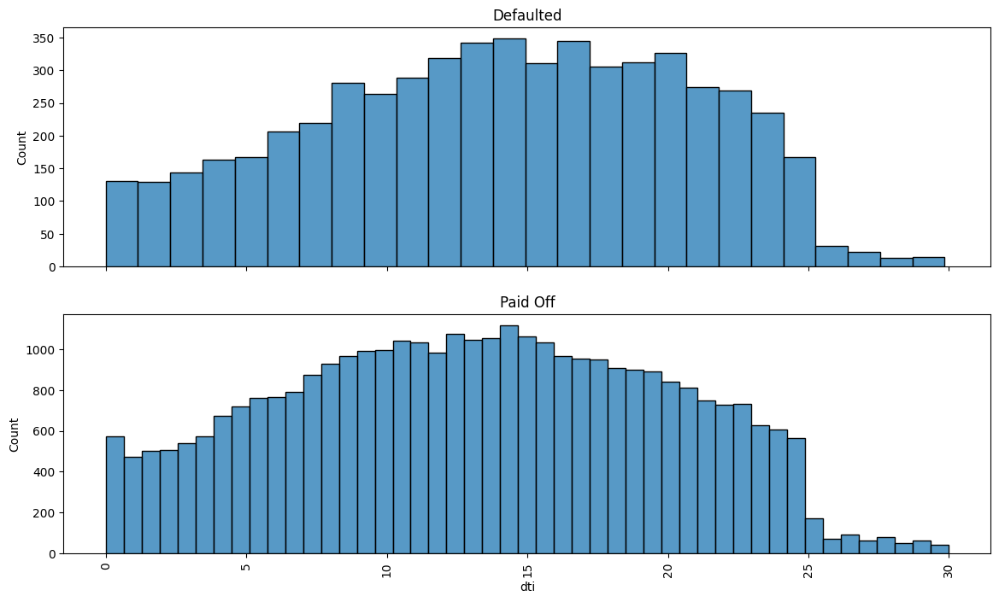
DTI vs Loan Status
Observations:
The DTI distribution for defaulted and paid-off portfolios is similar, suggesting it may not be a strong default indicator. However, an interesting pattern emerges: a cliff effect beyond a DTI of 25, indicating fewer loans given to borrowers with higher DTI.

Slide 28
Number of Inquiries vs Loan Status
Observations:
Borrowers with 6 or more inquiries in the last 6 months show a significantly higher default percentage.

Slide 29
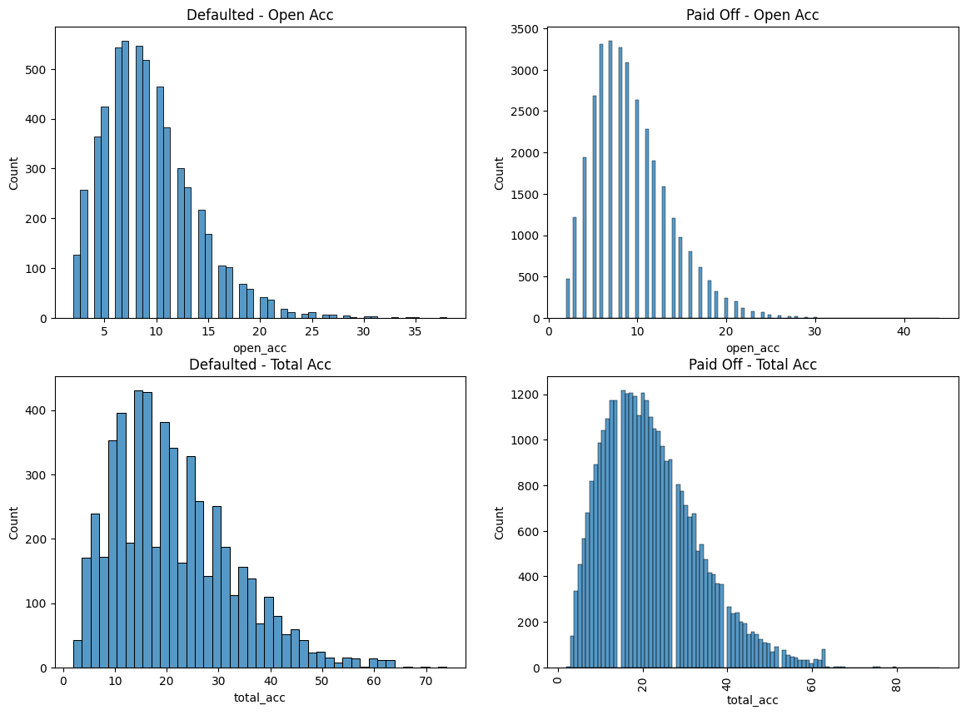
Open and Total Account vs Loan Status
Observations:
The distribution of total accounts is similar for both defaulted and paid-off portfolios, indicating it may not be a reliable indicator for default.
The distribution of open accounts displays fatter tails for defaulted portfolios compared to paid-off portfolios. Further analysis reveals a significant increase in default rates when the number of open accounts exceeds 25.

Slide 30
Public Record Bankruptcies vs Loan Status
Observations:
The Publicly recorded bankruptcies serve as a reliable indicator for default, as the default rate demonstrates a direct correlation with the number of publicly recorded bankruptcies.

Slide 31
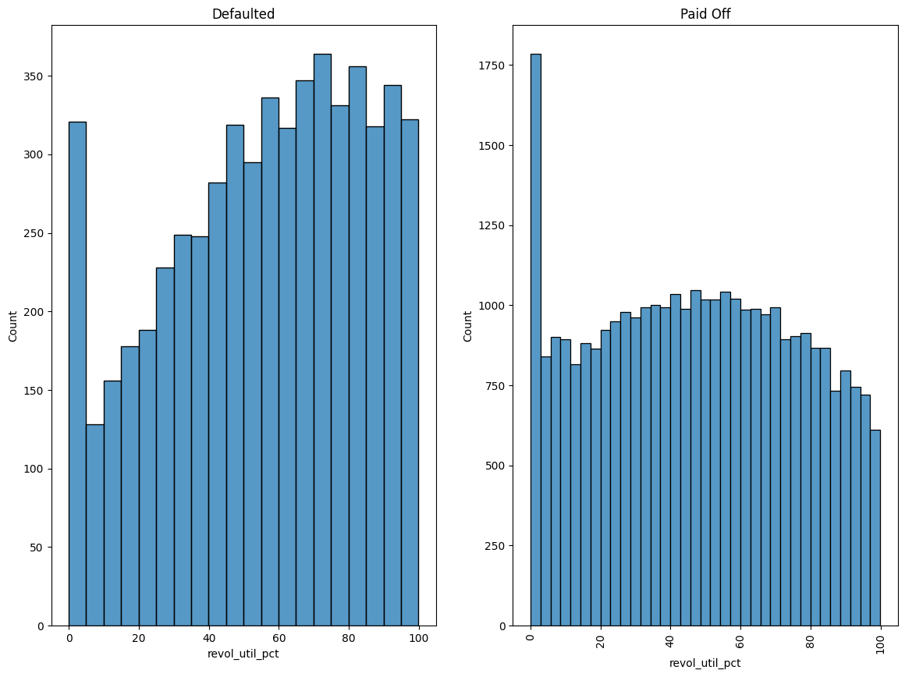
Revolving Utilization vs Loan Status
Observations:
There is a significant increase in the default ratio when the revolving utilization exceeds 80%.

Slide 32

Conclusion
Term of the loan is an important driving factor for default, shorter the maturity of the loan less risky it will be.
Grade is also a driving factor for the default, lower the grade higher is the chance of default.
Loan given for setting up small business carries the highest amount of risk followed by loan for renewable energies and education.
Following states show higher default ratio:
MO, FL, NV, AK, SD, NE
Among these NV and NE shows the highest default ratio.
Borrower who made 6 or more inquires in last 6 months shows a higher tendency of default.
Borrower who has 25 or more open account shows a higher tendency of default.
Borrower with 90% or more revolving utilization shows a higher tendency of default.
If a customer has any public record of bankruptcy then there is a much higher likelihood of default for that borrower.
Interest rate may look like as if it is good factor to identify default, however one must not take the higher correlation between high interest rate and default rate for the causation of default. Often financial institutes charge higher interest rate to high risk customer to compensate for the added risk, and since most of the time it is these high risk customer that default, we see a positive relationship between high interest rate and default, however interest rate is not a leading indicator of default but rather a lagging one.

Slide 33

Recommendation
The company should increase its long term loan exposure with better grade customer and at the same time should reduce its long term loan with the poor graded customer.
The company should be extra cautious when approving loan for small business, if possible company should ask for collaterals if a poor graded borrower ask for business loan that too for long term.
For few state like NV and NE where default rate is really high, company may consider closing its business there, given that these states gives a very small proportion of business to the company.
Company should add additional checks based on higher number of open accounts, higher revolving utilization while approving a new loan.
For customers with 2 or more publicly recorded bankruptcy the company should not approve the loan.

